Slide 1
BIRD STRIKE DATA VISUALIZATION

Slide 2

INTRODUCTION
Bird strikes, the collision between birds and aircraft, are a serious concern for aviation safety globally. To address this issue, comprehensive analysis and visualization of bird strike data are essential. This report presents an in-depth visualization of bird strike incidents, aiming to uncover patterns and trends that can inform strategies for mitigating bird strike risks.
The analysis focuses on [specific area of focus, e.g., geographical trends, seasonal patterns, bird species involved], utilizing [specific tools or techniques, e.g., data visualization software, mapping tools].

Slide 3

PROBLEM STATEMENT
Transport and communication are in the crucial domain in the field of analytics. Environmental impacts and safety are, nowadays, two major concerns of the scientific community with respect to transport scenarios and to the ever-growing urban areas. These issues gain more importance due to the increasing amount of vehicles and people. Seeking new solutions is reaching a point where available technologies and artificial intelligence, especially MAS, are being recognized as ways to cope with and tackle these kinds of problems in a distributed and more appropriate way.
A bird strike is strictly defined as a collision between a bird and an aircraft which is in flight or on a take-off or landing roll. The term is often expanded to cover other wildlife strikes - with bats or ground animals. Bird Strike is common and can be a significant threat to aircraft safety. For smaller aircraft, significant damage may be caused to the aircraft structure and all aircraft, especially jet-engine ones, are vulnerable to the loss of thrust which can follow the ingestion of birds into engine air intakes. This has resulted in several fatal accidents.
Bird strikes may occur during any phase of flight, but are most likely during the take-off, initial climb, approach and landing phases due to the greater numbers of birds in flight at lower levels. To have a closer look the following document visually depicts the data collected on Bird Strikes by FAA between 2000-2011.

Slide 4
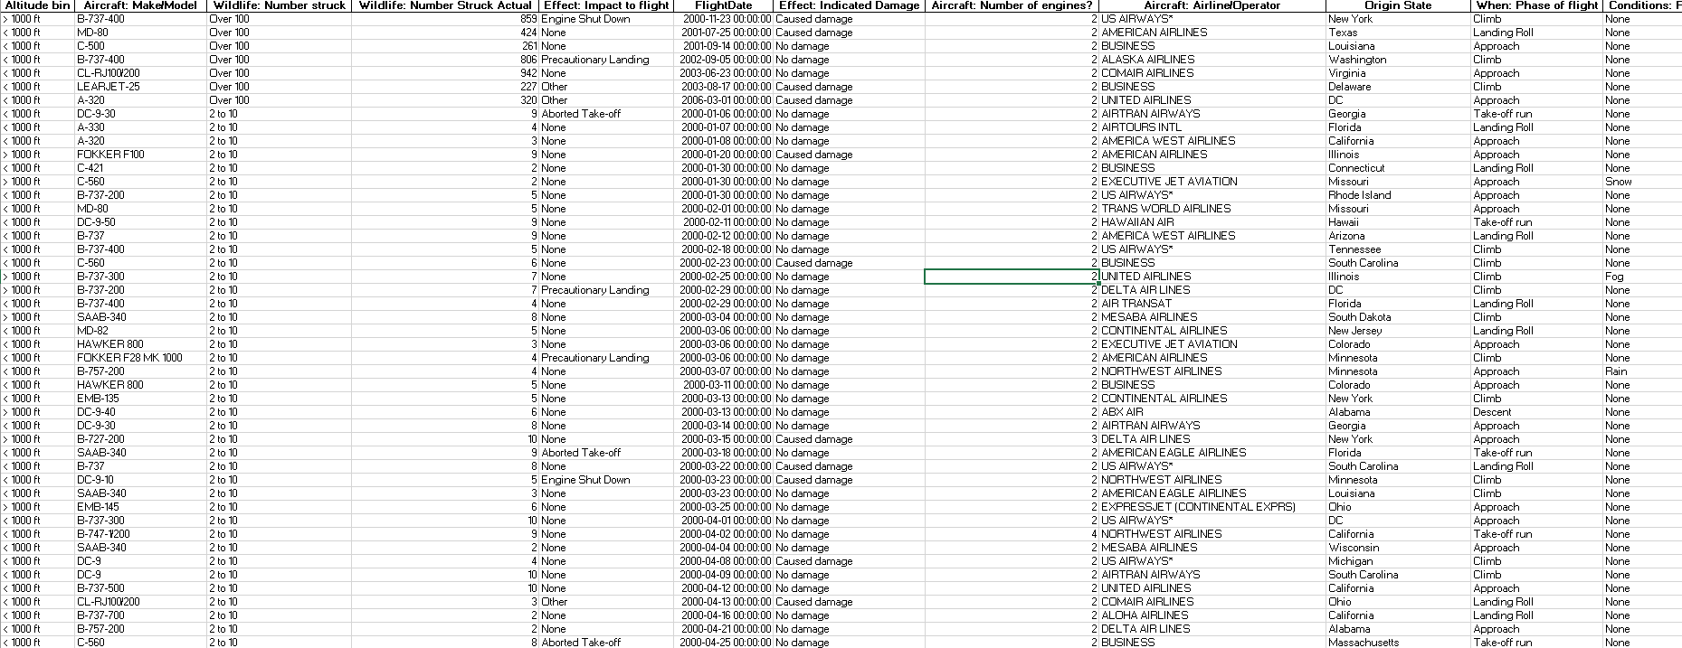
DATASET

Slide 5
Main KPIs
Visuals of Number of Bird Strikes
Yearly Analysis & Bird Strikes in the US
Top 10 US Airlines according to bird strikes
Altitude of Aeroplanes at the time of strike
Most Bird Strikes occur

Slide 6
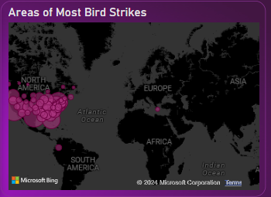
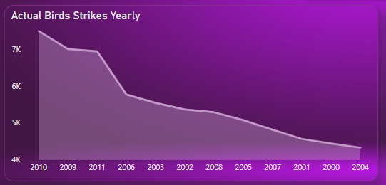
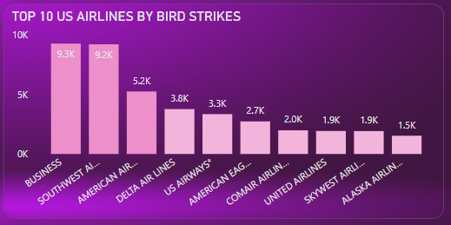
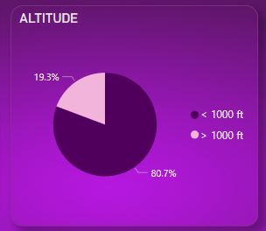
Charts Visualization

Slide 7
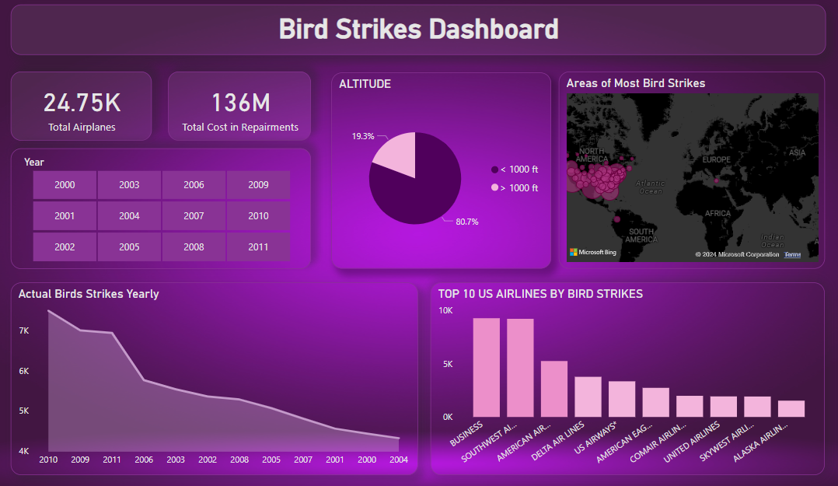
DASHBOARD

Slide 8
IN-SIGHTS
There is total Airplanes 24.75k, According to overall data.
Most of Birds Strikes happened in the California State with 6998(A Big Number).
80.7% of bird strikes incidents have happened when the altitude of the airplane was less than 1000ft & 19.3% have happened when the altitude was greater than 1000ft.
Top 3 Airlines with Most Bird Strikes are Business Airlines, Southwest Airlines and American Airlines.
Business Airlines are on the top with 9265 Strikes Actual.
2010 Year had the Most Strikes Record (7492).

Slide 9
Thank You

